Slide 1
Colonialism in Bengal, Partition of Bengal 1905 and the Formation of All India Muslim League

Slide 2
Points
What is colonialism and imperialism
How European colonial and imperialism began in Bengal.
What are the impacts: political, economic, social, religious.
Bengal resistance and rehabilitation
Bengal divide and the formation of Muslim League.
Aims and Objectives of a new political body in India
Cohesion between Muslim League and Congress

Slide 3
What is colonialism and imperialism?
Colonialism is a practice of domination, which involves the subjugation of one people to another. One of the difficulties in defining colonialism is that it is hard to distinguish it from imperialism. Frequently the two concepts are treated as synonyms. Like colonialism, imperialism also involves political and economic control over a dependent territory.
The etymology of the two terms, however, provides some clues about how they differ.
The term colony comes from the Latin word colonus, meaning farmer. This root reminds us that the practice of colonialism usually involved the transfer of population to a new territory, where the arrivals lived as permanent settlers while maintaining political allegiance to their country of origin.
Imperialism, on the other hand, comes from the Latin term imperium, meaning to command. Thus, the term imperialism draws attention to the way that one country exercises power over another, whether through settlement, sovereignty, or indirect mechanisms of control.

Slide 4
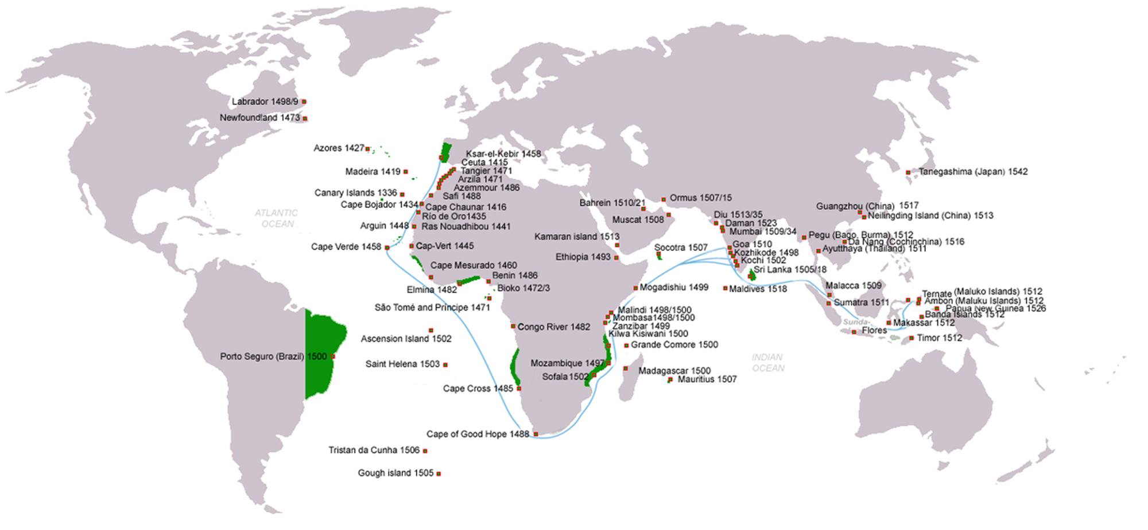

Slide 5
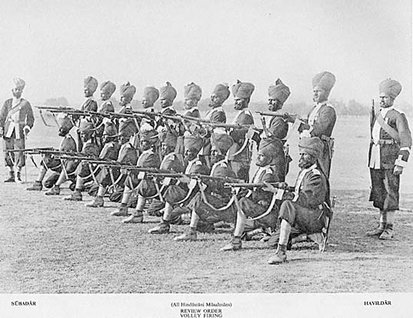
How European colonial and imperialism began in Bengal
This phase under Merchant Capitalism was marked by direct plunder and the East India Company’s trade, functioning through the ‘investment’ of surplus revenues in the purchase often at arbitrarily low prices of Indian (primarily Bengal) finished goods for export to England and Europe. British colonial rule in India was established in 1757 when East India Company established its hold over Bengal after the Battle of Plassey. The Company servants were significant founders of empire.
Aftermath of the Battle of Plassey (1757) was a reign of plunder and pillage. The English army and navy received the hefty sum of £ 275,000 for distribution among their members. The Company received Rs. 22.5 million from Mir Jafar. Lord Clive acquired a personal jagir worth of £34,567.16 Soon after the Plassey, state revenues were used to finance exports from India. Peasants were taxed and taxpayer’s money was used to buy cloth for exports. The availability of this option raised hopes among contemporaries of an end to ‘silver import’ into India. Until 1756, the East India Company had to import several hundred thousand pounds of silver into India in order to finance their trade in India. Following the Plassey, there was no import of silver into Bengal at all from 1757- 1797
While the number of soldiers under the Company command grew four times during the 1760s, the numbers of officers expanded tenfold to take advantage of the plunder or war. By 1770-71, the Company’s military and commercial spending had reached £ 3,210,000 that was 50 per cent more than its revenues.

Slide 6
After the British acquired the Diwani of Bengal, Bihar and Orissa in 1765, the maximization of revenue from the colony became the primary objective of the British administration. Agricultural taxation was the main source of income for the Company which had to pay dividends to its investors in Britain. The English tried out various land revenue experiments. Revenue assessments were enhanced between 1765 and 1769. Consequently, the land revenue collection increased by 53.8 per cent. It put severe pressure on the zamindars who became increasingly indebted to local creditors as well as European officers.
Lord Cornwallis in 1793 introduced the Permanent Settlement but this system also led to greater impoverishment of the tenant-cultivator because of the burden of high revenue assessment.
The second stage has generally seen to have begun with the Charter Act of 1813 when the Company lost its monopoly trading rights in India and ended in 1858 when the British Crown took over the direct control and administration of all British territory in India. The Industrial Revolution in England dramatically changed the whole pattern of trade and the years from 1813 to 1858 saw the classic age of ‘freetrader’ industrial capitalist exploitation converting India rapidly into a market for Manchester textiles and a source for raw materials, uprooting her traditional handicrafts a period when the 'home land of cotton was inundated with cotton'.

Slide 7
What are the impacts: political, economic, social, religious.
Bengal Famine
The British had a ruthless economic agenda when it came to operating in India and that did not include empathy for native citizens. Under the British Raj, India suffered countless famines. But the worst hit was Bengal. The first of these was in 1770, followed by severe ones in 1783, 1866, 1873, 1892, 1897 and lastly 1943-44. Previously, when famines had hit the country, indigenous rulers were quick with useful responses to avert major disasters. After the advent of British rule, most of the famines were a consequence of monsoonal delays along with the exploitation of the country’s natural resources by the British for their own financial gain.
Under the Mughal rule, peasants were required to pay a tribute of 10-15 percent of their cash harvest. This ensured a comfortable treasury for the rulers and a wide net of safety for the peasants in case the weather did not hold for future harvests. In 1765, the Treaty of Allahabad was signed and the East India Company took over the task of collecting the tributes from the then Mughal emperor Shah Alam II. Overnight the tributes, the British insisted on calling them tributes and not taxes for reasons of suppressing rebellion, increased to 50 percent. The peasants were not even aware that the money had changed hands. They paid, still believing that it went to the Emperor.
When partial failure of crops came in 1768, this safety net was no longer in place. The rains of 1769 were dismal and herein the first signs of the terrible drought began to appear. The famine occurred mainly in the modern states of West Bengal and Bihar but also hit Orissa, Jharkhand and Bangladesh. Bengal was the worst hit.
The colonial rulers continued to ignore any warnings that came their way regarding the famine, although starvation had set in from early 1770. Then the deaths started in 1771. That year, the Company raised the land tax to 60 percent in order to recompense themselves for the lost lives of so many peasants. Fewer peasants resulted in fewer crops, which in turn meant less revenue.

Slide 8
After taking over from the Mughal rulers, the British had issued widespread orders for cash crops to be cultivated. These were intended to be exported. Thus, farmers who were used to growing paddy and vegetables were now being forced to cultivate indigo, poppy and other such items that yielded a high market value for them but could be of no relief to a population starved of food. There was no backup of edible crops in case of a famine.
The East India Company Act 1813, also known as the Charter Act 1813, was an Act of the Parliament of the United Kingdom which renewed the charter issued to the British East India Company, and continued the Company's rule in India. However, the Company's commercial monopoly was ended, except for the tea and opium trade and the trade with China, this reflecting the growth of British power in India.

Slide 9
Permanent Settlement 1793
The Permanent Settlement, is also known as the Permanent Settlement of Bengal, was an agreement between the East India Company and Bengali landlords to fix revenues to be raised from land, with far-reaching consequences for both agricultural methods and productivity in the entire British Empire and the political realities of the Indian countryside. It was concluded in 1793 by the Company administration headed by Charles, Earl Cornwallis, also known as Lord Cornwallis.
It formed one part of a larger body of legislation enacted, known as the Cornwallis Code. The Cornwallis Code of 1793 divided the East India Company's service personnel into three branches: revenue, judicial, and commercial. Revenues were collected by zamindars, native Indians who were treated as the landowners. This division created an Indian landed class that supported British authority.
The Permanent Settlement was introduced first in Bengal and Bihar, and then in the south district of Madras and Varanasi. The system eventually spread all over northern India by a series of regulations dated 1 May 1793. These regulations remained in place until the Charter Act of 1833.

Slide 10
Social Changes
Education.
Raja Ram Mohan Roy established the Brahmo Samaj on August 20, 1828, which acted against the evil practices that existed in the Hindu society, especially, the practice of ‘Sati’, wherein a woman jumps into the funeral pyre of her husband.

Slide 11
Resistance
The Faqir and Sanyasi Rebellions (1770–1820s): The establishment of British control over Bengal after 1757 led to increase in land revenue and the exploitation of the peasants. The Bengal famine of 1770 led peasants whose lands were confiscated, displaced zamindars, disbanded soldiers and poor to come together in a rebellion. They were joined by the Sanyasis and Fakirs. The Faqirs were a group of wandering Muslim religious mendicants in Bengal. Two famous Hindu leaders who supported them were Bhawani Pathak and a woman, Devi Choudhurani. They attacked English factories and seized their goods, cash, arms and ammunition. Maznoom Shah was one of their prominent leaders. They were finally brought under control by the British at the beginning of the 19th century. The Sanyasi Uprisings took place in Bengal between the periods of 1770- 1820s. The Sanyasis rose in rebellion after the great famine of 1770 in Bengal which caused acute chaos and misery. However, the immediate cause of the rebellion was the restrictions imposed by the British upon pilgrims visiting holy places among both Hindus and Muslims.
The Indigo Rebellion (1859-1862): The British adopted many ways through which they could increase their profits. They also started interfering with the basic means of livelihood of the people. Not only did they introduce new crops, they also brought new techniques of farming. Heavy pressure was put on the zamindars and peasants to pay high taxes and grow commercial crops. One such commercial crop was Indigo. The cultivation of indigo was determined by the needs of the English cloth markets. The discontent of the farmers growing indigo was mainly for three reasons: l They were paid very low prices for growing indigo; l Indigo was not lucrative as it was planted at the same time as food crops; l And loss of fertility of the soil because of planting indigo. The peasants launched a movement for non cultivation of indigo in Bengal. Hindu and Muslim peasants together went on strike and filed cases against the planters. They were supported by the press and the missionaries. The government passed orders in November 1860, notifying that it was illegal to force the raiyats to cultivate indigo. This marked the victory for the rebels.

Slide 12
Resistence
Farazi Movement (1838-1848): This was the first ever no-tax campaign against the British Government led by Shariatullah Khan and Dudu Mian. Their band of volunteers fought heroically with the armed group of Indigo planters and zamindars. It brought together all the cultivators of Bengal against the tyranny and illegal extractions by the landlords.
Wahabi Movement (1830’s-1860’s): The leader of the movement was Syed Ahmed Barelvi of Rae Bareilly who was greatly influenced by the teachings of Abdul Wahab of Arabia and Shah Waliullah, a Delhi saint. The movement was primarily religious in its origin. It soon assumed the character of a class struggle in some places, especially in Bengal. Irrespective of communal distinctions, peasants united against their landlords.

Slide 13
The Santhal Rebellion (1855-57): The area of concentration of the Santhals was called Daman-i-Koh or Santhal Pargana. It extended from Bhagalpur in Bihar in the north to Orissa in the south stretching from Hazaribagh to the borders of Bengal. The Santhals like other tribes worked hard to maintain their lives in the forests and wild jungles. They cultivated their land and lived a peaceful life which continued till the British officials brought with them traders, moneylenders, zamindars and merchants. They were made to buy goods on credit and forced to pay back with a heavy interest during harvest time. As a result, they were sometimes forced to give the mahajan not only their crops, but also plough, bullocks and finally the land. Very soon they became bonded labourers and could serve only their creditors. The peaceful tribal communities were now up in arms against the British officials, zamindars and money lenders who were exploiting them. Sidhu and Kanu were leading Santhal rebel leaders.
Titu Mir (1782-1831) a peasant leader who resisted the oppression of the local zamindars and European indigo planters on the peasantry with ultimate object of liberating the country from British domination. He was a leader of the tariqah-i-muhammadiya in Bengal, and his movement initially aimed at socio-religious reforms, elimination of the practice of shirk (pantheism) and bidat (innovation) in the Muslim society and at inspiring the Muslims to follow Islamic principles in their day to day life.
Titu Mir built a strong fort with bamboo poles at Narkelbaria in October 1831, recruited mujahids and gave them military training. The number of Mujahids soon rose to nearly five thousand. Having completed his military preparation Titu Mir declared himself Badshah (king) and urged upon the people to participate in jihad (sacred war) against the British. He soon established his control over the districts of 24 Parganas, Nadia and Faridpur. Titu Mir demanded tax from the zamindars of Taki and Gobardanga who implored protection of the English. An English contingent was sent from Calcutta. But the combined forces of the zamindars and the English sustained severe defeat in the hands of the mujahids (troops). Subsequently, Lord william bentinck sent a regular army against Titu Mir under Lieutenant Colonel Stewart consisting of 100 cavalry, 300 native infantry and artillery with two cannons.

Slide 14
Bengal Divide
BENGAL was partitioned in 1905, the scheme of partition, as devised by the British government of India, was denounced by the Hindu community of Bengal and supported by the Muslim community. Hence it is important to examine the reasons behind the conflicting attitudes adopted towards the partition by the different communities--Hindu, Muslim and British.
According to the British government the principal motive for the partition was that of administrative convenience. Bengal, with a population of seventy-eight million and an area of 189,000 square miles (Bihar, Chota Nagpur and Orissa being included in it) was too large a province to be efficientlv administered. Therefore, when in 1903, A H L Fraser, the Lieutenant-Governor of Bengal, proposed that the Dacca and Mymensingh districts should be separated from Bengal and trans- ferred to Assam, Lord Curzon readily agreed with.
The new province was to be called 'Eastern Bengal and Assam' with its capital at Dhaka and subsidiary headquarters at Chittagong. It would cover an area of 106,540 sq. miles with a population of 31 million comprising 18 million Muslims and 12 million Hindus. Its administration would consist of a Legislative Council, a Board of Revenue of two members, and the jurisdiction of the Calcutta High Court would be left undisturbed.

Slide 15
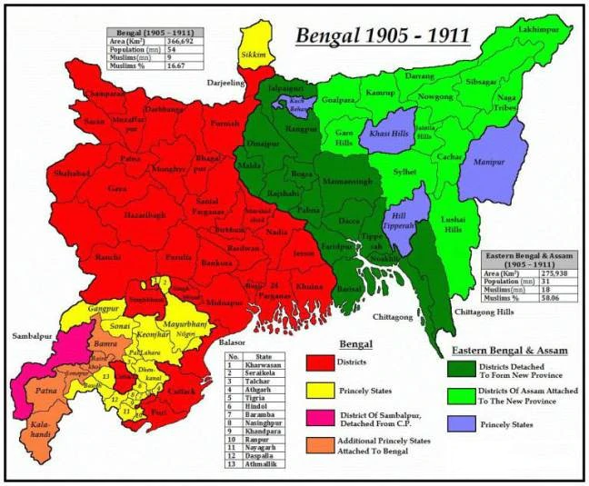

Slide 16
Reasons behind the Bengal Division
Governance: The lieutenant governor of Bengal had to administer an area of 189,000 sq miles and by 1903 the population of the province had risen to 78.50 million. Consequently, many districts in eastern Bengal had been practically neglected because of isolation and poor communication which made good governance almost impossible.
Firstly, it wanted to relieve the government of Bengal of a part of the administrative burden and to ensure more efficient administration in the outlying districts.
Secondly, the government desired to promote the development of backward Assam (ruled by a Chief Commissioner) by enlarging its jurisdiction so as to provide it with an outlet to the sea.
Thirdly, the government felt the urgent necessity to unite the scattered sections of the Uriya-speaking population under a single administration.

Slide 17
Political Motives
Fraser's motive was, of course, not purely administrative. It was political, too. Dacca and Mymensingh districts should be separated from Bengal, he pointed out to Curzon, because these two were "the hotbed of the purely Bengali movement, unfriendly if not seditious in character, and dominating the whole tone of Bengali administration.
Lord Curzon's original scheme for the partition published in the Gazette of India on December 12, 1903, proposed to transfer the Chittagong Division, Dacca and Mymensingh districts and Hill Tippera to Assam, and Chota Nagpur to the central provinces. It proposed to compensate Bengal to some extent by adding some Oriya-speaking areas from Madras and the Central Provinces to Bengal. This scheme, if carried out, would have relieved the Bengal government of the burden of administering eleven million people. The scheme, however, aroused the anger of the Hindu community of Bengal and drew no support from the Muslim community.
The idea that Bengal was divided in order to undermine the political strength of the Bengalis has survived to the present day.

Slide 18
It was regarded "as a national calamity, in the sense that it would alienate Hindus and Mohamedans, interfere with the solidarity of the Bengali-speaking population, and weaken their political influence“. The Hindu leaders of Bengal accused the British government of following a "divide and rule" policy, of playing one community off against the other.
Apart from the emotional factors, there were some practical reasons which inspired the Hindu opposition to the partition of Bengal. In the government's open dislike for the predominance of Calcutta, the Hindu leaders saw a desire to punish Calcutta and its citizens for the prominent part they had played in the Congress. On the other hand, the division of Bengal affected some professional and commercial interests.
Thus the lawyers of Calcutta were disturbed at the prospect of the establishment of a separate high court in Dacca and the business interests were vexed at the reduction of the size of their market. Such elements were agitated at the partition of Bengal for practical reasons.

Slide 19
Boycott as a Weapon
Boycott was a double-edged weapon. On the one hand, it would hurt the economic interests of the British and on the other it would promote the development of indigenous industries by increasing the demand for home production. The boycott and Swadeshi movement were thus recognized as, sources of power and wealth. "We recognized that boycott of foreign goods", wrote Rabindranath Tagore, "was a means for strengthening us not a mere instrument for annoying others.
The boycott and Swadeshi movement created a spirit of sacrifice among the Hindus of Bengal. They would purchase inferior home-made goods at a higher price than the British goods. New industries were founded, Swadeshi stores were opened and educational institutions for im- parting national education were

Slide 20
Countervailing Measures:
  Initially, the British government did not take the boycott and Swadeshi movement seriously, hoping that it would collapse over time. But as the movement gained momentum, they responded with repressive measures such as the prohibition of picketing, ban on meetings, censor- ship of the press.
  The failure of the boycott movement to produce any effect on the British government led a section of the Bengali youth to resort to political violent. They borrowed their method from Europe, especially from Ireland where shooting had long been recognized as a legitimate political weapon in the fight against an unpopular government.
  Violence and regionalism were the other two outgrowths of the partition. Apart from the Mutiny and a small terrorist society in Poona in the 1890s, terrorism is a post-1905 development. Whether terrorism would have appeared in Bengal without the partition is not known. Certainly, terrorism attracted a strong following because the partition reinforced the belief that Bengalis were being persecuted by the British. Regionalism had deep pre-20th century roots

Slide 21
Formation of All India Muslim League
After the revolt of 1857 Muslims became the target of the British hatred and suffered most from its consequences. The decline of Muslim power created a sense of loss among the Muslims of India. Sir Syed Ahmad Khan, the first post Mutiny thinker tried hard to raise the economic conditions by promoting modern education for them. The Mohammedan Anglo- Oriental College, Aligarh and the Muslim Educational Conference were by far the most lasting achievements in the political organization of Muslims.
They began to see that they must organize themselves so that they become a worthy object of government patronage. The first man to try to meet the situation was Nawab Abdul Lateef (1823- 1893) the first member of Bengal Legislative Assembly. In April 1863 he laid the foundation of an Islami Majlis- i- Muzakira, better known as the Mohammedan Literary Society, at Calcutta. While the Mohammedan Association of Calcutta formed in January 1856 was the oldest Muslim organization. Abdul Lateef was concerned to preserve and to promote old Muslim tradition.

Slide 22
The object of the society was “to impart useful information to the higher and educated classes of the Mohammedan community by means of lectures delivered in Urdu, Persian and Englishlanguages.”For more than thirty years Nawab Abdul Lateef, by his own account „almost alone” represented the Muslims of Bengal in all public movements and proceedings.” His efforts were supplemented by another Muslim, when Syed Ameer Ali (1849- 1928) established the National Mohammedan Association in May 12, 1878 at Calcutta with the same object.
Sir Syed Ahmad Khan the first post Mutiny thinker to realize the pathetic condition of the Muslims. He wrote a treatise in Urdu “Asbab- e- Baghawat- e- Hind” on the causes of the Indian Revolt in which he boldly indicated the Government of India for its lack of social intercourse between the British and the Indian public. According to him, the basic cause of the Legislative Councils. For the welfare of the stability of the Government the people must have a voice in its Councils.However,soon after the publication he process of the reforms- e.g., the appointment of Indians to the Legislative Councils was stared.

Slide 23
His aim was not only to confined to the reconciliation of the Muslims to the Government but also reconcile them to the Hindus. He believed that all people of a nation should co-operate for national development. Sir Syed Ahmad Khan organized a British India Association in 1886, the first Hindu Muslim organization. Mohammedan- Anglo- Oriental College at Aligarh in 1875.
The Partition of Bengal created fearful turmoil in the country; the two communities were divided into two antagonistic groups- one opposing the partition and other supporting it. This action of the Government was fully supported by Nawab Salimullah of Dacca. He decided to organize the Muslims of the new province into a compact body. Thus under him the Mohammedan Political Union came into existence. The Government of India also began to recognize the Muslim uneasiness and in a way sided with them which gave moral confidence.

Slide 24
The meeting of the Muslim elites held at Lucknow in the mid of September 1906 to finalize the text of the memorial to be presented to the Viceroy, decided to take advantage of the annual gathering of Muslim representatives on the occasion of the anniversary of the All India Mohammedan Educational Conference and establish an all India political body of the Muslims.
The meeting also unanimously adopted the proposal given by Mian Mohammad Shafi, Aftab Ahmad Khan, Mohsin- ul- Mulk and Viqar- ul- Mulk regarding the name of the organization as “Muslim League.” The first concrete step towards the foundation of a Muslim organization was taken by Nawab Salimullah of Dacca in his scheme circulated in November 1906 regarding the formation of the Muslim All India Confederacy‟. The scheme was discussed by the selected gathering of Muslim Leaders who had assembled to attend the 20th session of All India Mohammedan Educational Conference at Dacca in the Christmas week of December 1906. Soon after the Educational Conference was over on 30th December, as per programme a public meeting of Muslim delegates was held at the initiative of Nawab Salimullah. Hence, the All India Muslim League emerged on 30 December 1906.

Slide 25
Objective of Muslim League
The promotion of loyalty to British Government among the Muslims, the protection and promotion of the Muslim Political rights and interests and the prevention of hostility and promotion of inter communal unity were declared the main objects of the Muslim League.
Some of the aims of the newly founded body were:
(a) To support all measures emanating from the government,
(b) To advance the interests of the Muslims throughout India,
(c) To control growing influence of the Congress,
(d) To find scope for the Muslims according to their ability for public life, who had in the absence of proper education joined Congress party.
(e) To promote friendly feelings between the Muslims and other communities in India, as far as possible.
In this way from the very beginning League made it clear that it aimed at promoting the interests of the Muslims with the blessings and co-operation of the government, to whom the organisation will always be loyal. For them loyalty of government was more important than the nationalist movement.

Slide 26
Annulment of the Partition of Bengal
The Civil Disobedience
Swadeshi movement
Annulled in December 1911 at the Coronation Darbar of King George V in Delhi
The two parts of Bengal were reunited
Partition of Bengal formally ended on 1 April, 1912.
An administrative change was made: the Government of India should have its seat at Delhi instead of Calcutta.

Slide 27
The Aftermath
Negative impact on the Muslims – not only of Bengal but also on the whole Muslims of India – they were angry and dissapointed.
Muslims realized that loyalty does not pay, agitation would
Hence, the dejected Muslims gradually took on anti-British stance.
Hindu nationalism became explicit in India which had been recognized as a secular ground.
The Muslim did not like Congress to support anti partition movement. They thought that their interest will no longer served by the Congress.
Muslims were hardly poor in 170 years back but now it is impossible for them to be rich.

Slide 28
British Appeasement Policy to Muslims
In 1917, the Government of Bengal issues a circular for one third of all government posts to be filled by the Bengali Muslims.
In 1912 decided to establish Dhaka University and High Court in Dhaka.
The establishment of the Dhaka University in 1921 was a consolation prize for the Muslims of east Bengal.

Slide 29
Impacts on Bengal Politics
Reducing the importance of Calcutta: their citizens became deprived.
Reducing the hegemony of Calcutta based Bhoddorlok.
Calcutta real estate value has declined.
The relocation of Calcutta as prime center of politics agitated the Calcutta based Hindu educated class.
The Swadeshi and Boycotts movements adopted by the Bengali was latter adopted by the Indian Congress. They joined these two activities with the Gandhi`s non-violent based no-coperation movement.
The Indian learned the lessons that organized politial agitations and critical public opinion can force government to accept public demands.
On the other hand Muslim thought that they need to uphold their communal identity and political party like Muslim league will only safeguard their interests.
British were succeded to inject the idea of divide and rule and also physical divide the Bengal/India. They sucessfully introduced the idea of terrtorial identity. And neutralize the participation of Muslims in Indian Congress.

